Slide 1
Initiative 31
Weekly, 24th May 2024
Heiko Klare

Slide 2

Agenda
Team / Technology Assignment (Follow-Up)
Project Name
Collaboration Platforms
Weeklies
Questions / Discussion
Green boxes contain information added / agreed on in the meeting

Slide 3



Team Composition
as discussed in the weekly meeting
Team GTK
Latha Patil (ETAS)
Kulkarni Sudhindra Krishnarao (ETAS)
Theo Dann-Muirhead (Renesas)
William Riley (Renesas)
Team Swing
Deferred – reassignment depending on progress in other teams
Team Skia
Denis Ungemach (SAP)
Michael Schneider (SAP)
Federico Jeanne (Vector)
Heiko Klare (Vector)

Slide 4
Project Name
In the weekly meeting, no voices against starting with this name
“Initiative 31” more than a working title?
Short for: “Initiative for replacing 3 SWT implementation with 1”
Who want to make this the actual project name?
I will send a mail with today’s slides asking for complains / other proposals to give everyone the chance to communicate their opinion on it.

Slide 5



Collaboration Platforms
Lightweight, direct exchange
Proposal: Slack organization
Alternative:
Eclipse Matrix Chat (but bad experience with setting up encryption certificates), → start with Slack
Data exchange and documentation
Proposal: GitHub organization

Slide 6
Weeklies
My wishes / expectations:
Low overhead: in general, no preparation necessary
Exchange about progress (informal, low overhead)
Discussion of impediments / issues
Platform for presentations (results, idea, issues, …)
Your wishes / expectations?
Present and discuss findings that might make us drop a technology
Ask for help (find out if someone can help with certain topics, not help within meeting)

Slide 7
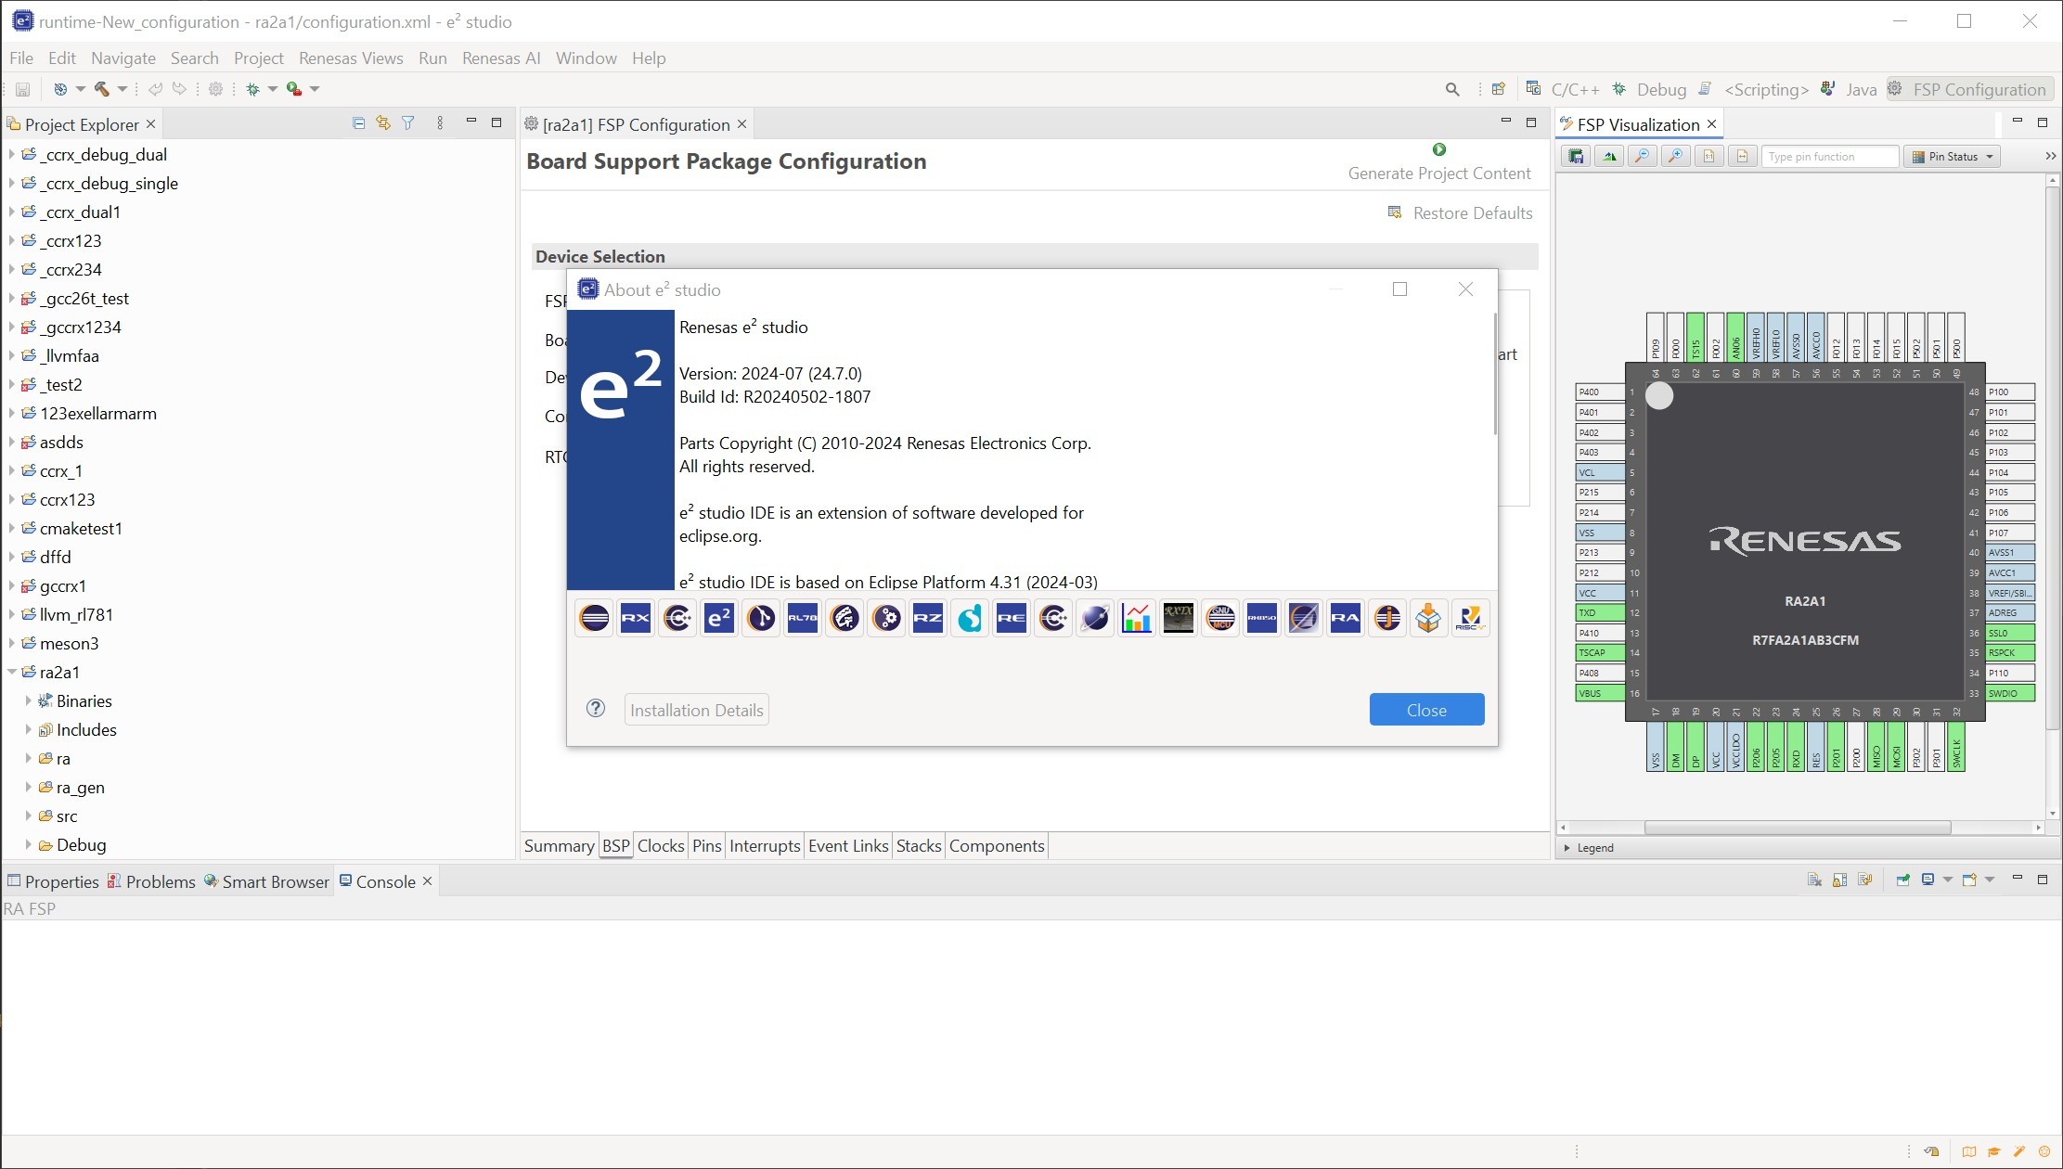
First GTK on Windows Results (Renesas)
William shows prototype
Includes JavaFX
Next evaluation step: Deployment
GTK tasks to distribute (e.g., between Renesas / ETAS)
MacOS port
GTK4
…
Thank you for the demonstration!

Slide 8
See you next week!

